Slide 1




Path Navigation of Autonomous Agents using Artificial Intelligence

Slide 2


PROBLEM STATEMENT
Suppose that you have been asked to develop an agent program that gives the trajectory of a mobile robot R, proposed to move from location A to location B. The sequence of transitions/hops the robot makes for reaching destination B is called the PATH of R and the algorithms associated to this are called path planning algorithms. If we also compute the derivatives of the path such as velocity, acceleration, rotation rate, etc. In other words, motion planning is not just concerned with the sequence of poses/moves or path it takes but it also precisely dictates how the robot moves through the environment. Considering the Formulate, Search and Execute Strategy create a path planning solution for robot R that moves from location A to B in the shortest cost path.

Slide 3

APPROACH
Import Libraries:
Import necessary libraries, including pandas for data manipulation, folium for creating maps, and networkx for working with graphs.
Haversine Formula Function (calculate_distance):
Define a function that calculates the distance between two points on the Earth's surface using their latitude and longitude.
Read Data:
Read city data from an Excel file using pandas.
User Input:
Take user input for the source and destination cities.
Find Cities in DataFrame:
Search for the source and destination cities in the DataFrame.
Calculate Distances:
If both source and destination cities are found, calculate the distances from the source city to all other cities using the Haversine formula and add them to the DataFrame.

Slide 4
APPROACH
7.Display Distance Table:
Print a table showing each city and its distance from the source city.
8.Create Folium Map:
Create a Folium map centered around the source city.
Add markers for each city and highlight the source and destination cities with red markers.
9.Create NetworkX Graph:
Create an undirected graph using NetworkX to represent connections between cities.
Add nodes for each city and edges with weights representing distances.
10.Find Minimum Spanning Tree (Prim's Algorithm):
Use Prim's algorithm to find the minimum spanning tree (MST) of the graph.
11.Display MST on Folium Map:
Add the edges of the MST to the Folium map in green.
Apply A* on mst
12.Save Map:
Save the Folium map with the minimum spanning tree as an HTML file.
13.Print Output:
Print messages indicating the completion of the process or an error if one or both of the specified cities are not found.

Slide 5

ALGORITHM
1. Input the map of the environment using folium library , including the city names for locations A and B, and their latitude and longitude co-ordinates.
2. Apply Haversine formula to find the cost path between the starting city A and the destination city B. This will give us a subgraph that connects A and B
3. From the Haversine formula you will get the distance between the places .
The haversine formula to calculate the distance between two cities is given as :
a = sin²(ΔlatDifference/2) + cos(lat1).cos(lt2).sin²(ΔlonDifference/2)
c = 2.atan2(√a, √(1−a))
d = R.c

Slide 6
where,
ΔlatDifference = lat1 – lat2 (difference of latitude)
ΔlonDifference = lon1 – lon2 (difference of longitude)
R is radius of earth i.e 6371 KM or 3961 miles
and d is the distance computed between two points.
4.Apply prim’s algorithm to find the shortest path between the cities.
Create a set mstSet that keeps track of vertices already included in MST.
Assign a key value to all vertices in the input graph. Initialize all key values as INFINITE. Assign the key value as 0 for the first vertex so that it is picked first.
While mstSet doesn’t include all vertices
Pick a vertex u that is not there in mstSet and has a minimum key value.
Include u in the mstSet.
Update the key value of all adjacent vertices of u. To update the key values, iterate through all adjacent vertices.
For every adjacent vertex v, if the weight of edge u-v is less than the previous key value of v, update the key value as the weight of u-v.

Slide 7
5. Continue executing the path until the the destination city B is reached.
6. If the destination city B cannot be reached due to unforeseen obstacles or other constraints, terminate the execution and return an appropriate message.
7.Finally show the shortest path between the cities in the map.

Slide 8
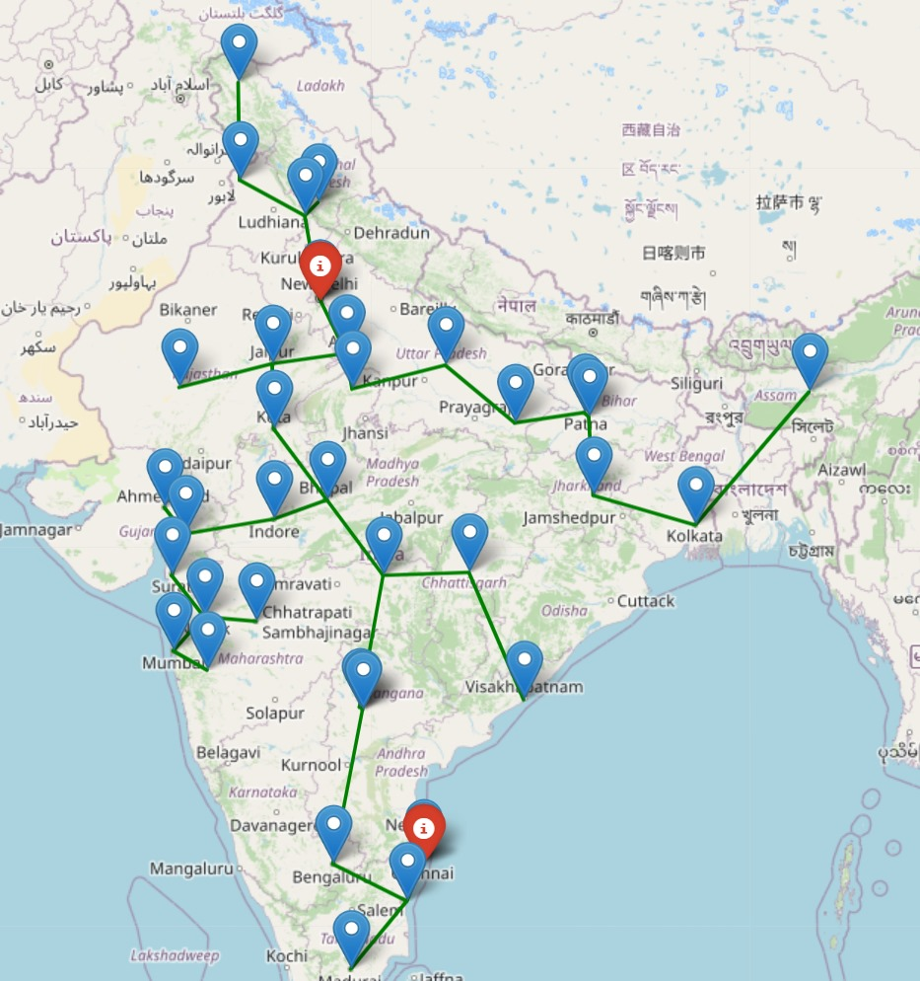

Slide 9
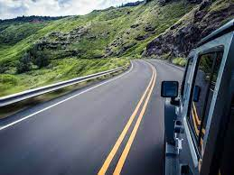
CONCLUSION
In conclusion, a major advancement in the field of robotics and autonomous systems has been made with the use of artificial intelligence in the path navigation of autonomous agents. In order to provide efficient and adaptive navigation, a variety of complex algorithms and integrated systems have been developed. Autonomous agents now have a full framework to navigate a variety of dynamic settings thanks to the interaction of vision, localization, path planning, obstacle avoidance, decision-making, and control systems. As the subject develops, it will be crucial to handle issues like uncertainty, real-time processing, and human interactions in order to deploy intelligent navigation systems widely.

Slide 10
THANK YOU

